Slide 1
ADVOCACY SLIDE DECK
SERIES 4
Information for Caregivers

Slide 2
Have you agreed to be a caregiver for someone you care about who is living with metastatic breast cancer?
A caregiver may have many duties, including
Coordinating transportation, needed care and services
Helping with activities of daily living
Accompanying family or loved ones to medical appointments
Preparing meals
Offering emotional support
Assisting with family responsibilities
Assisting with paperwork and knowing where it is, i.e. insurance coverage, medical bills, Advanced Health Care Directive, power(s) of attorney
© 2025 Metastatic Breast Cancer Alliance

Slide 3
Caregivers may have access
to protections and benefits, including:
Protection against discrimination at work for being a caregiver through the Americans with Disabilities Act (ADA) and state fair employment laws
Federal and state job-protected time off, state and local paid and unpaid leave
Employer leave programs, including paid time off and co-worker donations of leave
State Medicaid home care programs to get paid as a family caregiver
Respite care programs for caregivers, including state or local programs
and long-term care insurance
More information can be found at TriageCancer.org/Guide-Caregiver
and at the resources linked through the QR Code listed at the end of the presentation.
© 2025 Metastatic Breast Cancer Alliance

Slide 4
Taking Care of the Caregiver
While your heart is in the right place as a caregiver, it is important for caregivers to take care of themselves, too.
WHY?
Caregivers may focus on the needs of their loved ones or friends who have MBC and might neglect their own needs.
© 2025 Metastatic Breast Cancer Alliance

Slide 5
Emotions Emerge During Caregiving
As time passes, you may begin to have strong feelings associated with this new role and the changing needs of your loved one.
Some common emotional reactions of caregivers include:
Anger - aimed at yourself, family members, or the person you are caring for
Grief - because of what is happening to your loved one’s health or the time you had before becoming their caregiver
Loneliness – missing out on the life you had before, or the perception that no one understands what you are going through as a caregiver
Fear – about the responsibilities you have taken on and/or concerning the loss of your loved one
Source: https://www.mbcalliance.org/projects/here-all-year/caregivers-and-mbc/
© 2025 Metastatic Breast Cancer Alliance

Slide 6
Addressing Caregiver Emotions
While such strong feelings are common, what can you do?
Realize that you are not alone.
Talk with a family member, friend, or spiritual leader.
Your doctor, a social worker or a peer support group may also help.
Ask for, and accept help with caregiving duties. More help will also benefit your loved one who is ill. Some people may not be able to help, but others will.
Find resources that may help, such as those at the National Alliance for Caregiving (www.caregiving.org/resources).
© 2025 Metastatic Breast Cancer Alliance

Slide 7
Healing Strategies for Caregivers
Actions for Life Balance
Keep up with your interests. It is important to maintain your own pleasurable activities
Doing something you like to do each day,
no matter how small
Connecting with friends, exercise, playing with kids or pets, walking, gardening, pursuing a hobby
Whatever you do, don’t neglect yourself!
Consider joining a Caregiver Support Group so you connect with other caregivers and share ideas
© 2025 Metastatic Breast Cancer Alliance

Slide 8
Healing Strategies for Caregivers
Actions for your Body and Spirit
Maintaining your health check-ups
Not skipping meals
Taking prescribed medicines
Getting adequate sleep
Taking time to relax, rest, and consider meditation or yoga
© 2025 Metastatic Breast Cancer Alliance

Slide 9
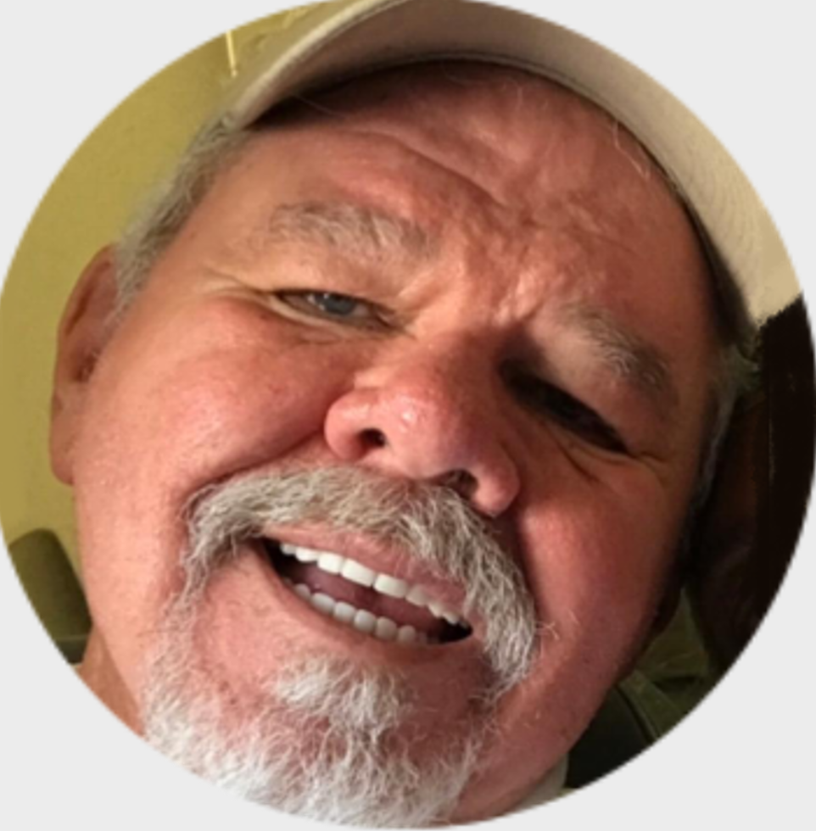
Caregiver Voice
Caregiver Voice
As a caregiver, I find myself in a position I never anticipated. My wife was diagnosed with MBC in 2015. Initially, my role was more intense because the impact of her treatment on her—Taxol in particular. Through the years, I’ve tried to lighten her load around the house as well as go to medical appointments as needed. Because my wife is a strong, independent person, giving up duties is not easy. I believe she sees it as a loss.
My wife is my life, and I will do whatever I can to care for her, but I do not want to make her feel she can’t do things on her own. As her caregiver, I feel it is my responsibility to take on that daily load on, day-by-day, as she feels it is time to relinquish things. She is a beautiful, strong, independent, and intelligent woman who wants to control her daily life as long as she is able.
It is my responsibility to care for her as she would me.
John,
Caregiver
© 2025 Metastatic Breast Cancer Alliance
© 2022 Metastatic Breast Cancer Alliance

Slide 10
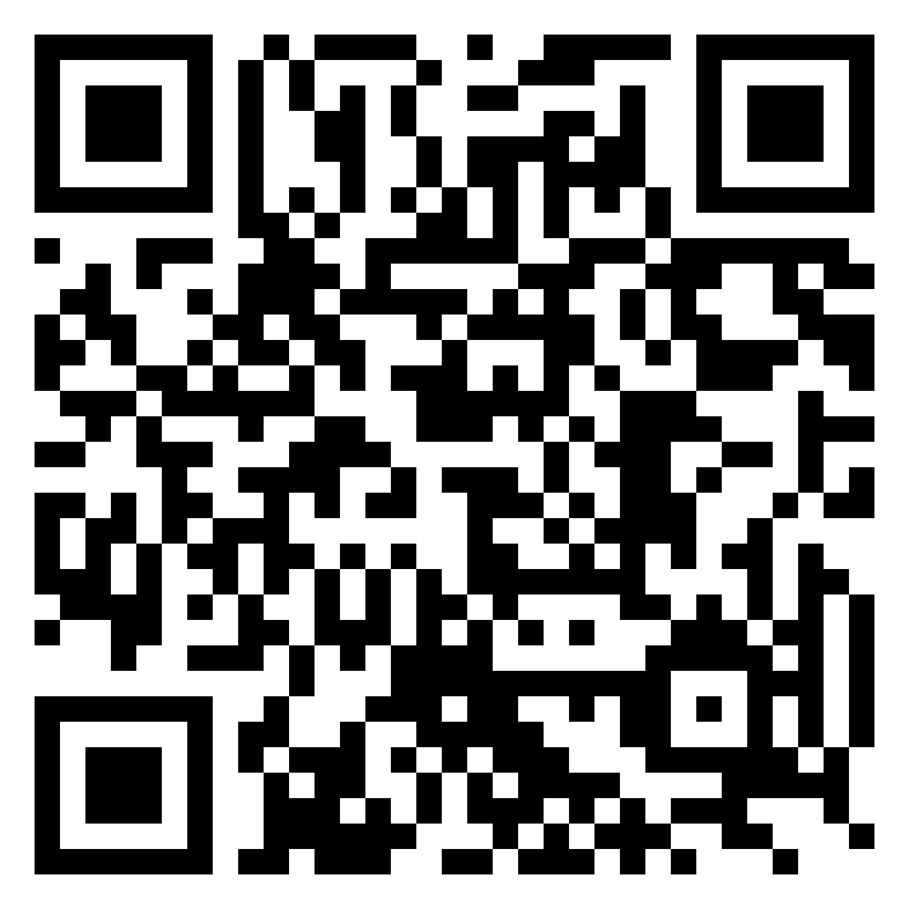
THANK YOU! Questions?
For more information and specific sources, visit:
https://mbcalliance.org/asd-series4
© 2025 Metastatic Breast Cancer Alliance

