Slide 1
ADVOCACY SLIDE DECK
SERIES 3
Challenges in Metastatic Breast Cancer: Big Issues That Could Change Lives

Slide 2
How many people in the US live with MBC?
Currently, there are only estimates of how many women and men are living with MBC in the US
Why is there no accurate total count?
Only people who receive an MBC diagnosis as their first or De Novo diagnosis are counted
People who receive an MBC diagnosis after being treated for early-stage breast cancer are not counted
© 2025 Metastatic Breast Cancer Alliance

Slide 3


Counting every MBC patient
is important because…
What we do not count can be easily overlooked, and MBC research needs to receive a fair portion of the breast cancer research funding.
© 2025 Metastatic Breast Cancer Alliance

Slide 4
The improvement in breast cancer survival rates has slowed
ASCO's website, cancer.net, estimated that 42,250 women would die from breast cancer in 2024.
Breast cancer is the second leading cause of cancer death in women. (Only lung cancer kills more women each year.)
Black women have the highest death rate from breast cancer. This is thought to be partially because Black women have a higher risk of triple-negative breast cancer, more than any other racial or ethnic group.
The chance that any woman will die from breast cancer is about 1 in 40 (about 2.5%).
Women of all ages receive MBC diagnoses.
Younger women and males are more likely to receive an MBC diagnosis as their first diagnosis.
Source: https://www.cancer.net/cancer-types/breast-cancer/statistics
© 2025 Metastatic Breast Cancer Alliance

Slide 5
Deaths of so many women from MBC impact the socioeconomic well-being of the US
Women are paid and unpaid workers in society
Mothers are often responsible for the well-being, care, and education of their children. Children are left behind without the love and guidance of women in their families. Single parent families are hit particularly hard.
Younger women may lose the opportunity to become mothers and wives.
Women lose the opportunity to contribute to and advance in the workplace, if/when they become disabled.
Women of all ages also act as caregivers for others in and outside the home.
Women comprise the majority of teachers and nurses in US society.
© 2025 Metastatic Breast Cancer Alliance

Slide 6
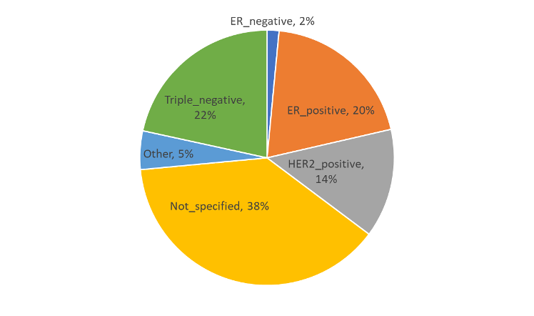
MBC still does not receive enough research funding
Despite efforts to quantify the percentage of breast cancer research dollars going to MBC research, the most complete analysis to date comes from the 2020 MBC Alliance Landscape Analysis Update.
Percent of grants investigating MBC treatment resistance by subtype
U
In 2014-2020, 13% of all breast cancer research dollars was devoted to MBC. Therefore, investment in MBC as a percentage of breast cancer research nearly doubled for grants funded in 2014-2020 compared to 7% in 2000-2013.
/ DOD 2016
The percentage of National Institutes of Health and Department of Defense/ Breast Cancer Research Program MBC research in fiscal year 2016 was estimated by the National Breast Cancer Coalition to be approximately 20%.
By 2020 People living with MBC identified treatment resistance as the area of primary importance for MBC research. The percent of MBC research dedicated to resistance increased from 15% ($36.6 million) in 2014 to 26% ($89.1 million) in 2020.
Sources: See accompanying Sources and Support document
© 2025 Metastatic Breast Cancer Alliance

Slide 7
Proposed Solutions
Patient advocacy is key to changing research focus and outcomes
Lobby for research that is focused on what matters to patients
Consider becoming active in research advocacy by participating in scientific projects and attending conferences
Consider lobbying your congressional representatives to support funding for cancer research through the DoD Breast Cancer Research Program
© 2025 Metastatic Breast Cancer Alliance

Slide 8
MBC needs focused research
With an estimated 43,780 people dying of MBC in the US each year, research to improve outcomes of those living with metastatic disease is crucial
There are areas of great need…
Including patient advocates and nonprofit partners in research when asking what’s needed to prevent death and improve quality of life
Turning MBC into a chronic illness that can be lived with for a full lifetime, with a good quality of life, even if a cure is not attainable for all
Preventing brain metastasis and central nervous system involvement
Identifying better treatments for each subtype
Overcoming treatment resistance
Resolving care disparities, including those of race, age, gender, wealth, and location
Establishing and improving supportive and palliative care access
Supporting basic and translational science that may lead to new clinical trials
Improving clinical trial design and making plain language summaries available to participants
Including more representative patient participation in clinical trials
© 2025 Metastatic Breast Cancer Alliance

Slide 9
Addressing disparities in MBC
Across the country, disparities prevent many MBC patients from accessing high quality health care and affordable treatments
These disparities include socioeconomic status, race, age, where people live, language, gender, sexual identity and orientation, and access to health care
If these disparities are reduced, more patients might live longer than the current median 3 years
The concept of disparities need to expand to include financial disparities and the toxicities of the financial burdens of MBC
© 2025 Metastatic Breast Cancer Alliance

Slide 10
Proposed Solutions
The bipartisan Telehealth Extension and Evaluation Act is proposed legislation to extend current Medicare telehealth reimbursement waivers through May, 2025 and commission a study on evaluating permanent telehealth flexibility. This bill serves to address inequities that result from living in rural or underserved areas.
The Metastatic Breast Cancer Access to Care Act is again in Congress with two Bills proposed for legislation: House Bill HR3183 and Senate Bill S1312. Passing of this Act would remove the wait-time barriers for receiving Social Security Disability Insurance and access to Medicare.
Urge your representatives to support these legislative efforts. You can find contact information for your Senators and Representatives and by going to https://www.usa.gov/elected-officials.
© 2025 Metastatic Breast Cancer Alliance

Slide 11
Access to palliative care for MBC
The right time for palliative care is early and ongoing
Palliative Care
The American Society of Clinical Oncology recommends early access to palliative care in MBC
…introduction to palliative approach
Ongoing medical treatments as appropriate
Whether called palliative or supportive care, the goal is to support a patient physically, emotionally, spiritually, and socially through
Integrative Oncology: Complementary medicine therapies in conjunction with conventional cancer treatments, such as naturopathy, acupuncture, cancer massage, and Reiki
Cancer Pain Management: Medications and interventions to manage cancer pain and minimize side effects
Cancer Psychiatry/Psychology: Supporting the mental health of cancer patients
Cancer Nutrition: Maintaining and optimizing nutrition in cancer patients
Cancer Rehabilitation: Preventing and improving physical limitations and function
Living with a life-limiting illness with any prognosis
Hospice Care/
Home Support
Psychosocial support
of patient/family
Symptom
management
Condition is non-curative
End-of-Life Care
Terminal Care
Maximizing
Quality of Life
Weeks to months
to live
Symptom
management
Days to hours
of life
Palliative
Chemotherapy/
Radiotherapy
Symptom
management
Spiritual care
Spiritual
healthcare
Palliative surgery
Psychosocial
support
Maximizing
community supports
Psychosocial
support
Sources: https://ascopubs.org/doi/full/10.1200/JCO.2018.79.2721
https://hpc.providencehealthcare.org/about/what-palliative-care
© 2025 Metastatic Breast Cancer Alliance

Slide 12

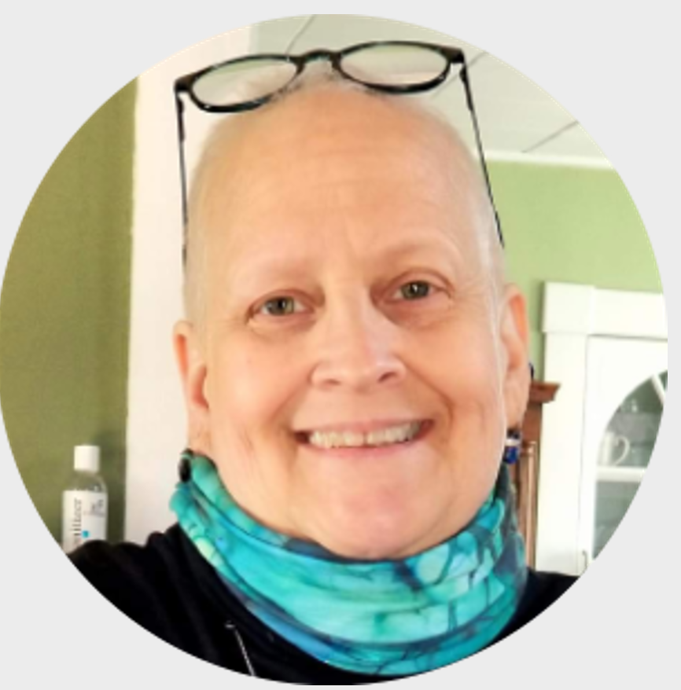
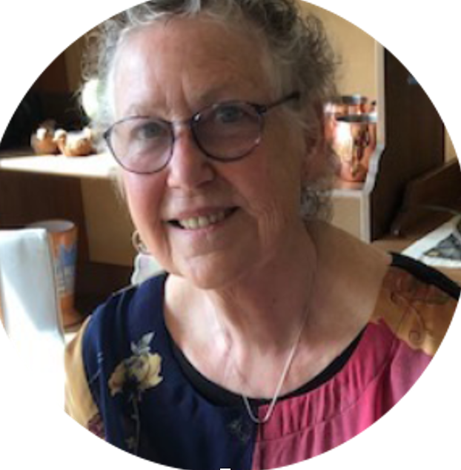

Patient Voices
For me, being a male with breast cancer I felt a little uncomfortable, being diagnosed with a “woman’s disease”... I focus on living. I focus on making plans, for dinner, for vacations, for time spent with family and friends and especially precious time with my wife… [But] be concerned for your children, for your sons & daughters, because breast cancer knows no boundaries and neither do our genes!
Kirby, MBC diagnosis in 2016
I was diagnosed with Stage II Invasive Ductal carcinoma (IDC) in 2011. My wife and I were devastated. We are fortunate to live in an open and affirming community where our sexual orientation has not created barriers for us or our children. In 2019, when we thought we had put cancer behind us, I was diagnosed with Stage IV Metastatic Breast Cancer. As before our community and healthcare providers welcomed my wife as a core part of my team. Not everyone is as fortunate as we are. I have a friend who has the same diagnosis. They consider themselves to be gender neutral and use “they/them” as their preferred pronouns. Because breast cancer is often thought of as a “female” cancer they have found both the healthcare system and the support group network unwelcoming and at times, downright hostile.
Melinda
MBC diagnosis in 2019
This is one way stopping fighting cancer empowers: [I choose] lesser opioids more often, extra-strength Tylenol, a steroid for inflammation, cannabis candy in my toolkit. My toolkit to adjust or not.
Dorothy (in memoriam)
MBC diagnosis in 2015
© 2025 Metastatic Breast Cancer Alliance

Slide 13

THANK YOU! Questions?
For more information and specific sources, visit:
https://mbcalliance.org/asd-series3
© 2025 Metastatic Breast Cancer Alliance

