Slide 1
ADVOCACY SLIDE DECK
SERIES 1
The Basics of Metastatic Breast Cancer
© 2022 Metastatic Breast Cancer Alliance

Slide 2
MISSION
The mission of the Metastatic Breast Cancer Alliance is
to amplify our collective efforts through collaboration & innovation to improve the lives of people living with
metastatic breast cancer.
© 2025 Metastatic Breast Cancer Alliance

Slide 3
What is Breast Cancer
When Breast Cancer Spreads
Metastatic Breast Cancer Statistics
Early Stage versus Metastatic Breast Cancer
Patient Voice
SERIES 1
Presentation Outline
© 2025 Metastatic Breast Cancer Alliance

Slide 4
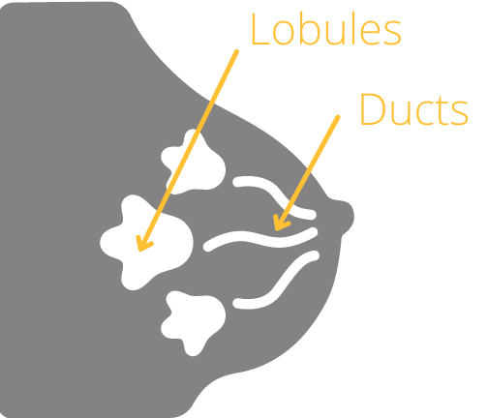
What is Breast Cancer?
Breast cancer is most commonly a carcinoma that develops in either the cells of the breast ducts or lobules
CARCINOMA IN SITU
Noninvasive breast cancer that stays within
the ducts or lobules
INVASIVE DUCTAL CARCINOMA
Cancer cells have escaped the milk ducts
and entered the breast or lymph nodes near the breast
INVASIVE LOBULAR CARCINOMA
Cancer cells have escaped the lobules
and entered the breast or lymph nodes near the breast
Both noninvasive and invasive cells can be part of the same cancer
Source: https://www.breastcancer.org/facts-statistics
© 2025 Metastatic Breast Cancer Alliance

Slide 5
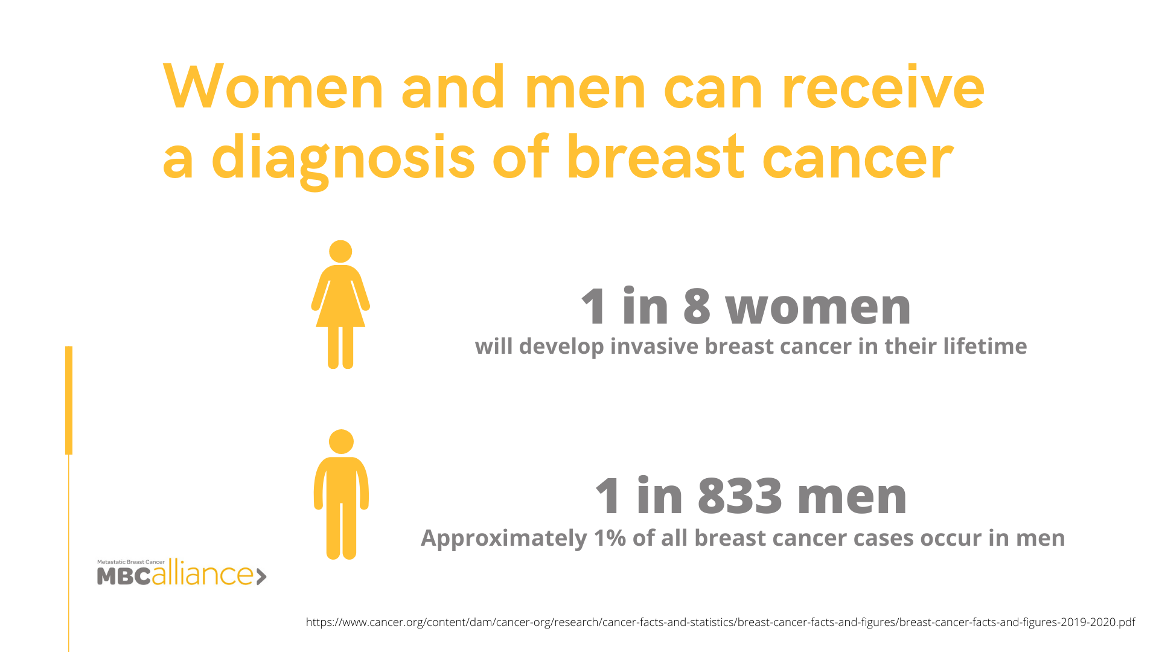
Women and men can receive
a diagnosis of breast cancer
1 in 8 women
Will develop invasive breast cancer in their lifetime¹
1 in 726 men
Approximately 1% of all breast
cancer cases occur in men²
Sources:
https://www.cancer.org/content/dam/cancer-org/research/cancer-facts-and-statistics/breast-cancer-facts-and-figures/2024/breast-cancer-facts-and-figures-2024.pdf
https://www.cancer.org/cancer/breast-cancer-in-men/about/key-statistics
© 2025 Metastatic Breast Cancer Alliance

Slide 6
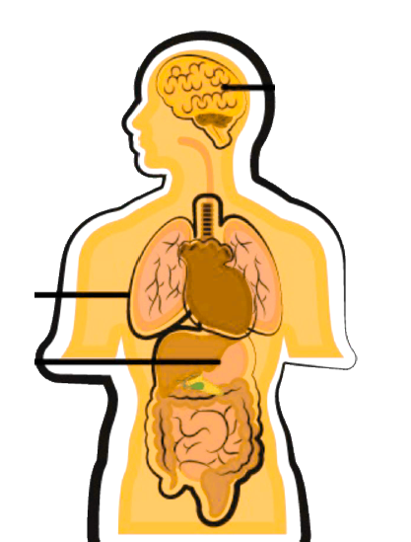

When Breast Cancer Spreads
Metastatic breast cancer (MBC) is breast cancer that has spread beyond the breast and nearby lymph nodes to other parts of the body.¹ Breast cancer most commonly spreads to the bone, brain, liver or lungs.²
Brain
No matter what organ is affected by breast cancer cells it is still called metastatic breast cancer and treated with breast cancer treatments
Lung
Bones
Liver
Sources:
https://www.breastcancer.org/pathology-report/breast-cancer-stages
https://www.cancer.gov/types/metastatic-cancer#how-cancer-spreads
© 2025 Metastatic Breast Cancer Alliance

Slide 7
Also referred to as Stage IV breast cancer or Advanced breast cancer
MORE ON MBC
Metastasis, or spread, can occur regardless of the size or stage of the primary tumor
Breast cancer cells spread through the lymphatic system or bloodstream to distant parts of the body, where they may remain inactive for months or years before they begin to grow again
Source: https://www.cancer.gov/types/metastatic-cancer#how-cancer-spreads
© 2025 Metastatic Breast Cancer Alliance

Slide 8
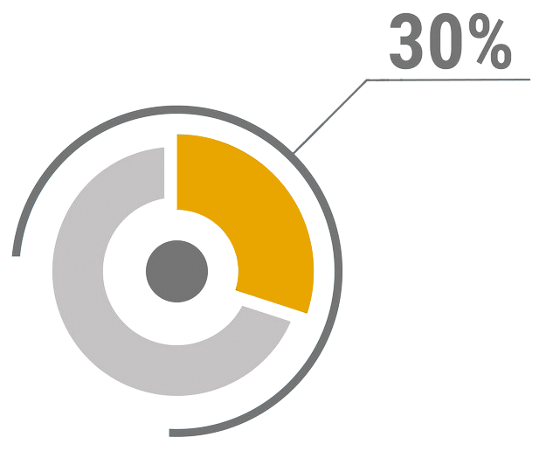
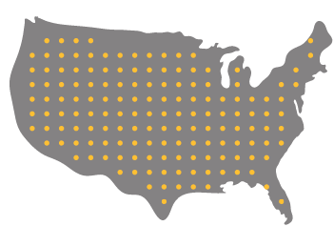
MBC Statistics
While the exact percentage of metastatic
recurrences among those treated for early-stage breast cancer is unknown, recent estimates suggest it is nearly 30%¹
De novo MBC means that the cancer was
metastatic upon first diagnosis. In the US, this accounts for 6% - 10% of people living with MBC²
It is estimated that there were 168,000
US women living with MBC in 2020³
Sources:
https://pmc.ncbi.nlm.nih.gov/articles/PMC3711134/
https://pmc.ncbi.nlm.nih.gov/articles/PMC5790843/
https://pmc.ncbi.nlm.nih.gov/articles/PMC5833304/
© 2025 Metastatic Breast Cancer Alliance

Slide 9


Early Stage versus Metastatic Breast Cancer
Early-Stage Breast Cancer
Confined to breast ducts and lobes and local lymph nodes
All cases counted
0, I, II, III
Only if untreated
Curative
Limited
Local 99%; Regional 87%
87% of all breast cancer research dollars
Metastatic Breast Cancer
Most common to bones, brain, liver, lungs
Only De Novo counted
IV
Incurable but treatable
Control disease and maintain QOL
For rest of patient’s life
32% women and 20% men
13% of all breast cancer research dollars
Location of disease
Number of cases
Disease stage
Threat to life
Treatment Goal
Treatment Length
5-Year survival rate
Research dollars
Source: American Cancer Society, Breast Cancer Facts & Figures, 2024-2025.

Slide 10

Patient Voice: Getting the diagnosis
My de novo MBC diagnosis was a complete shock. Asymptomatic and feeling great. Being a nurse of 40 years was no help at the beginning of the journey. I have to advocate every day for myself or someone else. But life continues and I fight to have a good quality of life.
Stephanie
MBC diagnosis in 2015
© 2025 Metastatic Breast Cancer Alliance

Slide 11

THANK YOU! Questions?
For more information and specific sources, visit:
https://mbcalliance.org/asd-series1
© 2025 Metastatic Breast Cancer Alliance

